Slide 1
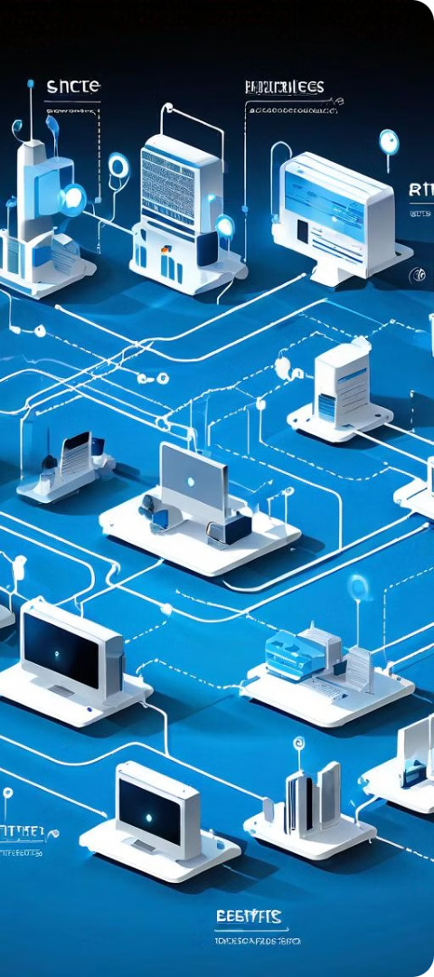
SSL, TLS, IPsec and Firewalls
Prepared by: Pranil Neupane
Pranaya Prasai
Kritik Poudel
Mahima Koirala
Bikash Shrestha

Slide 2

Introduction to Secure Socket Layer (SSL) Protocol
SSL (Secure Sockets Layer) is a widely adopted security protocol that provides a secure communication channel between a client and a server over the internet. It ensures the confidentiality, integrity, and authenticity of data exchanged between the two parties.

Slide 3

Purpose and Importance of SSL
1
Data Encryption
2
Authentication
3
Integrity
SSL encrypts data transmitted between the client and server, protecting sensitive information like login credentials, credit card details, and personal data from unauthorized access.
SSL verifies the identity of the website, ensuring that users are communicating with the legitimate server and not a malicious impersonator.
SSL safeguards data from tampering or modification during transmission, guaranteeing that the information remains intact and unaltered.

Slide 4

SSL Handshake Process
1
Initiation
The client initiates a connection with the server and requests a secure SSL session.
2
Negotiation
The client and server negotiate the encryption algorithms and exchange cryptographic keys to establish a secure communication channel.
3
Encryption
All subsequent data transmitted between the client and server is encrypted using the agreed-upon algorithms, ensuring confidentiality.

Slide 5
SSL Encryption Algorithms
Symmetric Encryption
Asymmetric Encryption
Hash Functions
Uses a single shared key for encryption and decryption, providing fast and efficient data protection.
Employs a public-private key pair, where the public key is used for encryption and the private key for decryption.
Generates a unique digital fingerprint of the data, ensuring its integrity during transmission.

Slide 6
What is TLS?
Purpose
Features
Importance
TLS is a cryptographic protocol that provides privacy and data integrity for communication over a network. It ensures that data transmitted between systems remains secure and cannot be intercepted or tampered with by unauthorized parties.
TLS incorporates features such as encryption, authentication, and key exchange to establish a secure connection between client and server. It supports various encryption algorithms and certificates to verify the authenticity of communicating parties.
TLS is fundamental for securing sensitive data, such as financial transactions, personal information, and confidential communications, across the internet. Its implementation is crucial for maintaining trust and privacy in digital interactions.

Slide 7
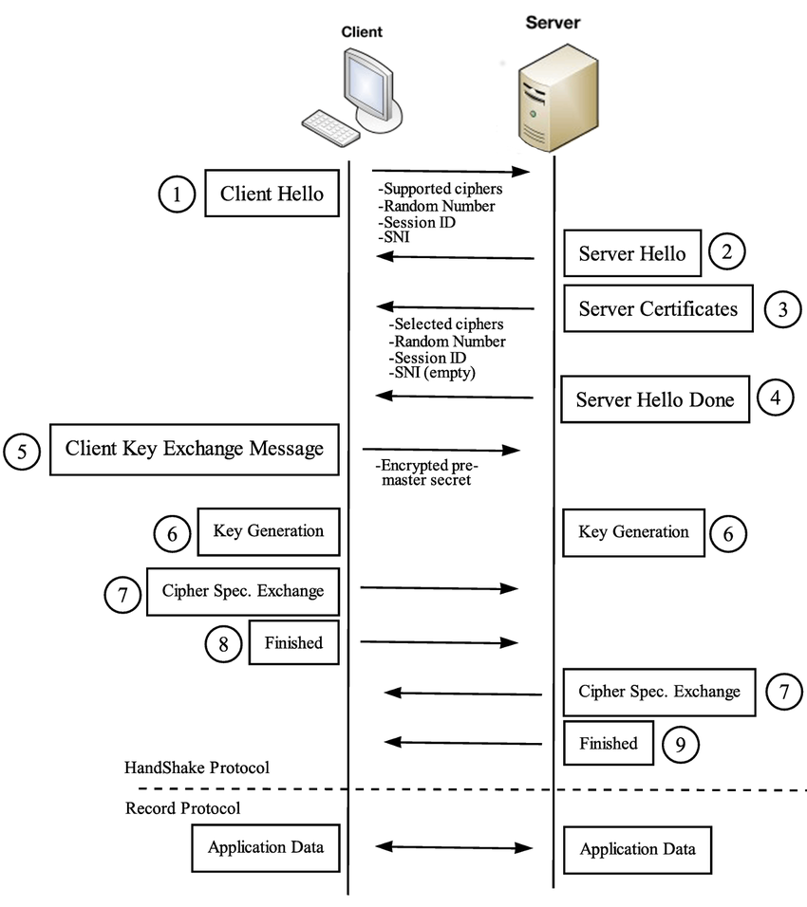
TLS Handshake Process
Key Steps
Significance
The TLS handshake involves key steps like client hello, server hello, certificate exchange, key exchange, and establishing the secure connection. Each step plays a vital role in negotiating encryption parameters and authentication between client and server.
The TLS handshake ensures mutual authentication, where both client and server verify each other's identities, and establishes session keys for secure communication. It sets the foundation for a secure and encrypted data exchange.

Slide 8
TLS Protocol Versions
TLS 1.0 | Released in 1999 | Support for SSLv3.0 | Vulnerable to POODLE attack
TLS 1.1 | Released in 2006 | Improved security features | Enhanced protection against cipher-block chaining (CBC) attacks
TLS 1.2 | Released in 2008 | Stronger cryptographic algorithms | Defenses against common vulnerabilities
TLS 1.3 | Released in 2018 | Enhanced security and performance | Reduced handshake time and improved key exchange

Slide 9
Use Cases of TLS
Web Browsing
Email Encryption
IoT Security
TLS is extensively used to secure HTTP connections, ensuring that data exchanged between web browsers and servers remains confidential and integral. It prevents eavesdropping and man-in-the-middle attacks during online interactions.
TLS facilitates the encryption of email communication, enabling secure transmission of messages between email servers. It prevents unauthorized access to email content and protects sensitive information shared via emails.
In the realm of Internet of Things (IoT), TLS plays a crucial role in securing device-to-device communication, data exchange, and remote management. It ensures the confidentiality and integrity of information exchanged within IoT ecosystems.

Slide 10
Introduction to IP Security
IPsec is a Internet Engineering Task Force (IETF) suite of protocols that provide secure communication over IP networks. It uses encryption and authentication to protect data confidentiality, integrity, and origin authentication.
IPsec achieves its objectives by dividing the protocol into two main protocols: AH(Authentication Header ) and ESP ( Encapsulation Security Payload).

Slide 11

Services of IPsec
1
Confidentiality
IPsec encrypts data packets to prevent eavesdropping and ensure that only authorized recipients can read them.
2
Integrity
IPsec uses message authentication codes (MACs) to detect any unauthorized modification of data packets in transit.
3
Authentication
IPsec verifies the identity of both the sender and the receiver to prevent spoofing and ensure data originates from a trusted source.
4
Replay Protection
IPsec prevents attackers from replaying intercepted packets by using sequence numbers and timestamps to ensure that each packet is unique and legitimate.

Slide 12



Authentication Header
Purpose
Process
Benefits
Authentication Header provides authentication and integrity protection for IP packets.
It adds an authentication header to the IP packet, containing a MAC that verifies the sender's identity and ensures data integrity.
AH protects against data modification and spoofing, enhancing the reliability of communication.

Slide 13
Encapsulation Security Payload
Encryption
Authentication
Confidentiality
ESP encrypts the entire IP packet, including the header, to protect confidentiality.
ESP adds a MAC to verify the sender's identity and ensure data integrity.
Provided by DES_CBC algorithm.

Slide 14
Security Association
Definition
A security association (SA) defines the parameters for secure communication between two endpoints.It is a unidirectional security arrangement defining a set of items and procedures in order to protect the communication process.
Since each AS establishes a unidirectional channel, for a full duplex communication between two parties, two SAs must be established.
Parameters
Security Parameter Index(SPI)
Security Protocol Identifier
IP destination Address
Encapsulation Mode

Slide 15

Encapsulation modes
Transport Mode
Tunnel Mode
Encrypts only the payload of the IP packet, leaving the IP header untouched. Ideal for applications requiring end-to-end protection.
Encrypts the entire IP packet, including the header. Used for securing communication between networks or gateways.

Slide 16
Firewall and Its Key Characteristics

Slide 17
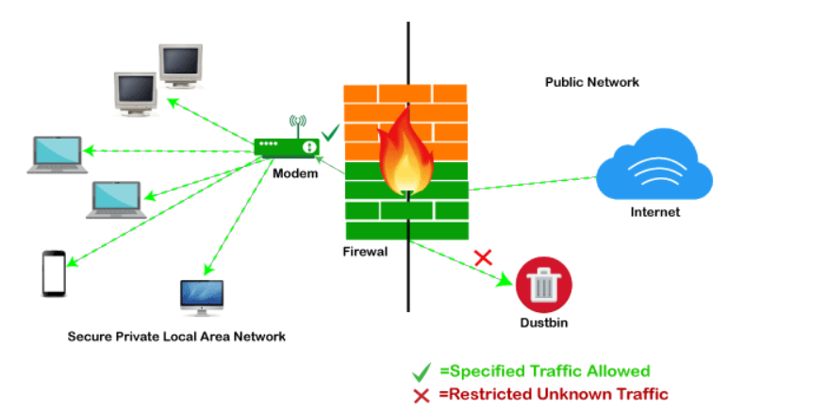
Introduction
Firewall is a network security device that monitors and controls incoming and outgoing network trafﬁc based on cyber threats predetermined security rules. It acts as a barrier between a trusted internal network and untrusted external network, providing protection against .

Slide 18
Advantages of Firewall
Promotes Privacy and Security
Firewalls may play a vital role in corporate security management. It offers enhanced security and privacy from vulnerable services. It stops unauthorized users from accessing a private network that is linked to the Internet. It keeps your data safe and secure.
2. Monitors Network Traffic
The firewall monitors the data from where it comes in and out of our system. It gives faster response time and the ability to manage larger traffic loads. This regulation has predetermined rules and associated filters.
3. Prevent Virus Attack
Virus attacks are very dangerous for the computer system, and they could close down all digital operations quickly. So it can update its security protocols from a single authorized device. It secures our system from a phishing attack. A firewall can prevent a hacker entirely or deter them from becoming easy targets. Firewalls serve as an important blockade against malicious programs and spyware. It helps you to keep your data safe from the external threats.

Slide 19
Disadvantages of Firewall
User Restriction
It is an undisputed fact that a firewall secures the system from unauthorized access, but the firewall is more advantageous to the single user but ineffective for the organization. It damages the organization's productivity and forces the employees to undertake shortcuts, which can lead to serious compromises with security. Employees are not permitted to perform a certain function that is not part of the policies used by the firewall.
5. Effect on the Performance
The computer system's performance is affected by the usage of software firewalls. It is a known fact that the RAM (Random Access Memory) and processing power have a vital and important role in giving a good performance, but when a firewall runs in the background, it draws more power from the RAM and processing power. This has an overall impact on the performance of the system.
3. Complex Operations
It becomes very difficult for a large organization to bear the huge maintenance cost of the firewall. A firewall is very efficient in individual cases. A separate team has to be constituted for the firewall's operation and to ensure the other networks remain secure from intrusion. It gives rise to an additional financial burden on the organization.

Slide 20

Key Characteristics
1. Web Filtering
Content Filtering features are used to regulate and control content access with their firewalls. This feature is very useful as it blocks the content, which is harmful. It is beneficial for home computing users.
2. Bandwidth Control and Monitoring
It helps IT management to determine how much actual bandwidth is available on the user's system. It facilitates determining the usage and regulating traffic flow, bandwidth hogs, and network pressure across the Information Technology environment.
3. Logging
The Firewall Rules Logging Features help the user to analyze, audit and verify the effect of firewall rules on their system.

Slide 21
4. Internet aggregation and SD-WAN
SD-WAN (Software Defined Wide Area Network) and Link Aggregation features are very beneficial to corporates requiring multiple Internet connections. They benefit from multiple connections and links to other sites, such as cloud services and branch offices.
5. Sandboxing
It can be defined as a cybersecurity practice where a user executes code, analyze and observe in an isolated and safe environment on a network that mimics end-user operating environments. It is used to stop threats from the networks by inspecting untested or untrusted code.

Slide 22
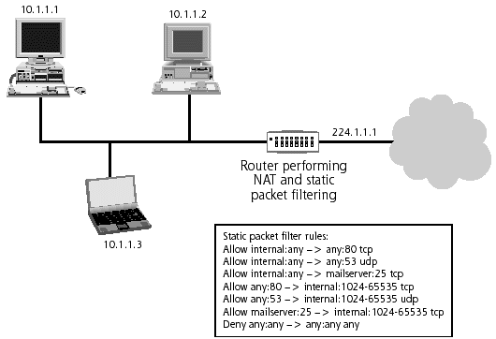
Packet Filtering Firewall
A packet filtering firewall is a network security device that filters incoming and outgoing network packets based on a predefined set of rules.
Analyzes packets in isolation and filters them based on predefined rules such as IP addresses, protocol types, and port numbers.
By inspecting packet headers the firewall decides if it matches packet is allowed; if not it blocks the packet.

Slide 23
It uses filtering table to decide whether to accept or reject packet.
Advantages: Simple, efficient, and low-cost; suitable for small networks.
Disadvantages: Limited inspection capabilities; can't prevent sophisticated attacks.

Slide 24
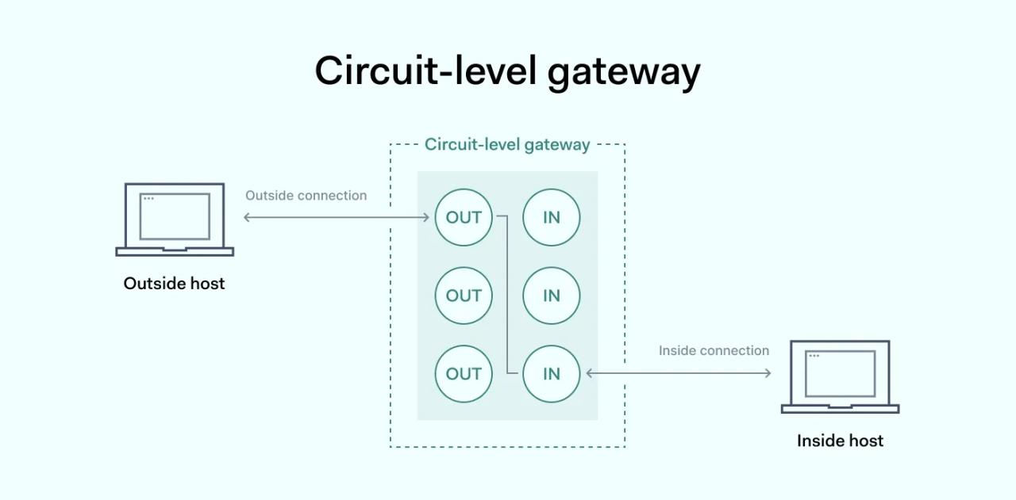
Circuit Level Gateway
A circuit level gateway is a solution designed to provide connection security to internal and external computers in a network's session layer.
All internal and external connection are managed in gateway.
First the devices are checked and only they are connected.

Slide 25
Uses two TCP/IP connection:
between internal host and gateway
between external host and gateway
Advantages: Efficient for session monitoring; hides the internal network structure.
Disadvantages: Doesn't inspect individual packets beyond the handshake; less effective at identifying data-driven attacks.

Slide 26
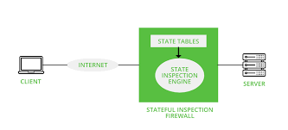
Stateful Inspection Firewall
A stateful firewall is a kind of firewall that keeps track and monitors the state of active network connections while analyzing incoming traffic and looking for potential traffic and data risks. It is important to monitor the state and context of network communications because this information can be used to identify threats—either based on where they are coming from, where they are going, or the content of their data packets.

Slide 27
Advantages: More secure than packet filtering as it understands the state of the traffic; can block more complex attacks.
Disadvantages: More resource-intensive; potentially slower performance due to state tracking.

Slide 28
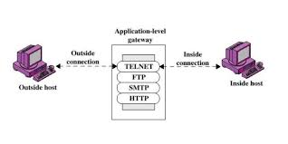
Proxy Firewall
A proxy firewall, also known as an application firewall or a gateway firewall,
It limits the applications that a network can support, which increases security levels but can affect functionality and speed. A proxy firewall is the most secure form of firewall, which filters messages at the application layer to protect network resources.
Acts as an intermediary between end users and the internet, inspecting traffic at the application layer. It can cache content, perform user authentication, and filter specific content.

Slide 29
Connects user by TCP/IP protocols(Telnet, FTP ,SMTP and so on)
Advantages: High level of security by understanding application-specific commands and protocols; can provide detailed logging.
Disadvantages: Slower performance due to deeper inspection; more complex to configure and manage.

Slide 30
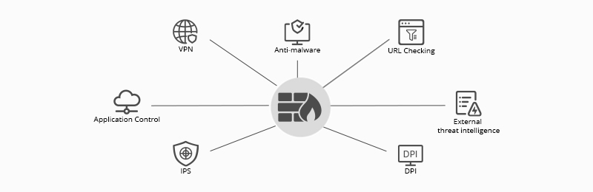
Next-Generation Firewall (NGFW)
A Next-Generation Firewall (NGFW) represents an advanced evolution of traditional firewall technology. NGFWs integrate multiple security features and capabilities to provide comprehensive protection against a wide range of threats. They go beyond basic packet filtering and stateful inspection by incorporating deeper and more sophisticated analysis of network traffic.
Combines traditional firewall capabilities with additional features like deep packet inspection, intrusion prevention systems (IPS), and application awareness/control. Often includes features like advanced threat

Slide 31
Advantages: Comprehensive security features in a single device; able to detect and prevent sophisticated threats.
Disadvantages: High cost; complex deployment and management; potential performance issues due to extensive inspection.

